Slide 1
Programming Fundamentals
By
Shazmeen Batool

Slide 2
Lab Task 1
Write a program to find first and last digit of a number.

Slide 3
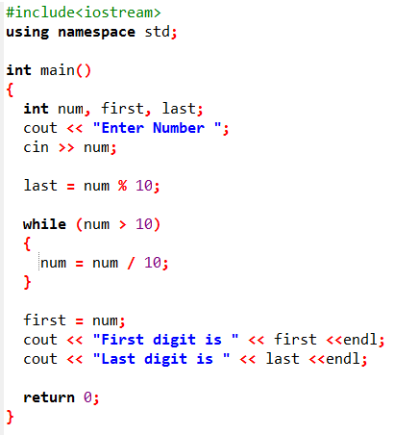

Output

Slide 4
Lab Task 2
Write a C++ program counts the number of digits in the number entered by user?

Slide 5
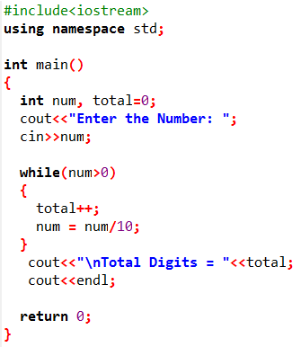

Also practice this code using for loop.
Output

Slide 6
Lab Task 3
Write a program to check whether a number is Armstrong number or not.
In the case of an Armstrong number of 3 digits, the sum of cubes of each digit is equal to the number itself. For example, 153 is an Armstrong number because
153 = 1*1*1 + 5*5*5 + 3*3*3

Slide 7
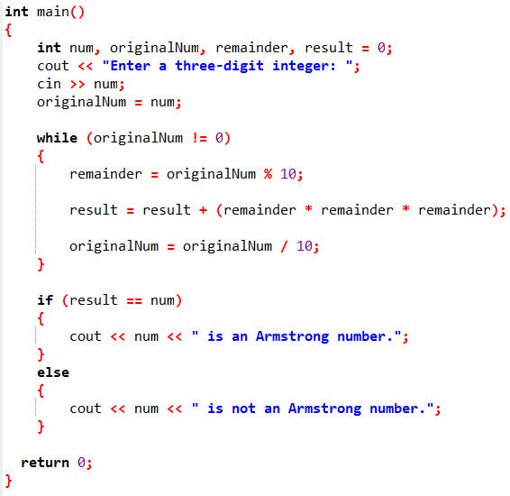


Slide 8
Lab Task 4
Write a do-while loop that asks the user to enter two numbers. The numbers should be added and the sum displayed. The user should be asked if he or she wishes to perform the operation again. If so, the loop should repeat; otherwise it should terminate.

Slide 9
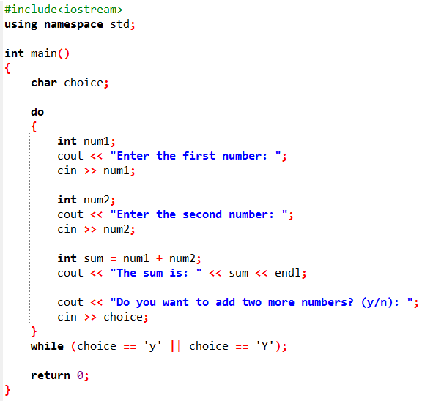
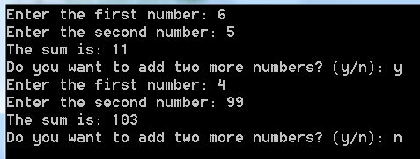

Slide 10
Lab Task 5
Imagine you're building a simple security system for a phone app. The app asks the user to guess a secret password (e.g., "open123"). The user must keep trying until they get it right. Use a do-while loop to handle this, since the loop should run at least once (to ask for the first guess).

Slide 11
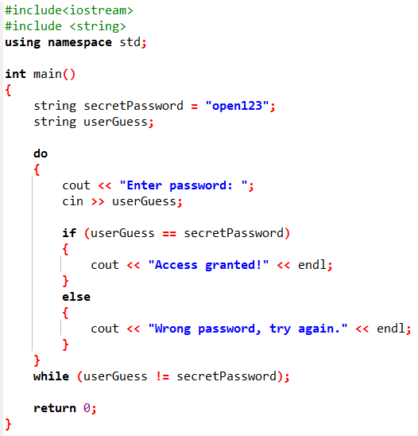
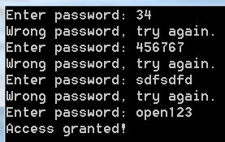

Slide 12

Lab Task 6
Write a program to print right triangle star pattern by using nested loops.

Slide 13
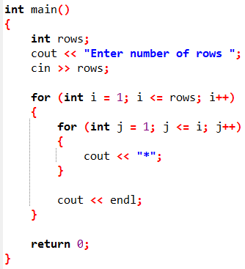
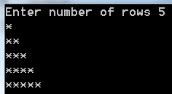

Slide 14

Lab Task 7
Write a program to print mirrored right triangle star pattern by using nested loops.

Slide 15
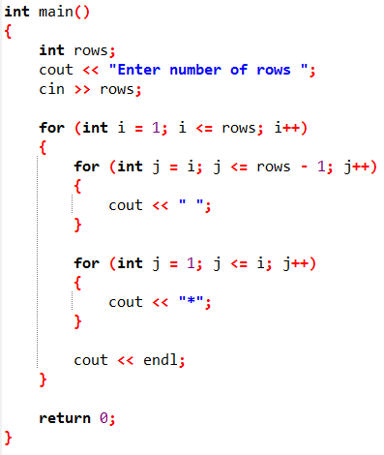
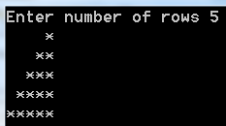

Slide 16

Lab Task 8
Write a program to print inverted right triangle star pattern by using nested loops.

Slide 17
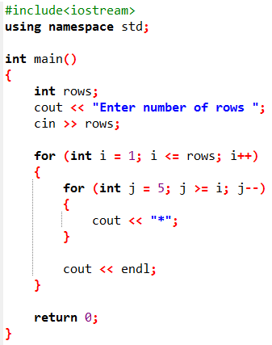
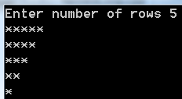

Slide 18

Lab Task 9
Write a program to print inverted mirrored right triangle star pattern by using nested loops.

Slide 19
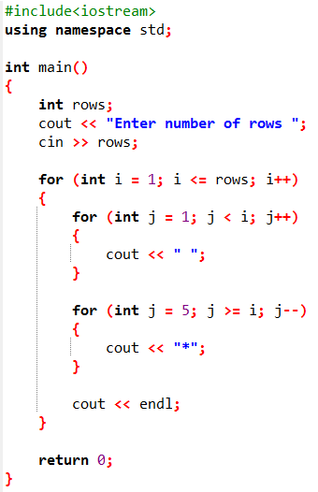
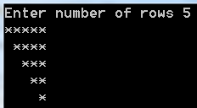

Slide 20

Lab Task 10
Write a program to print pyramid star pattern series

Slide 21
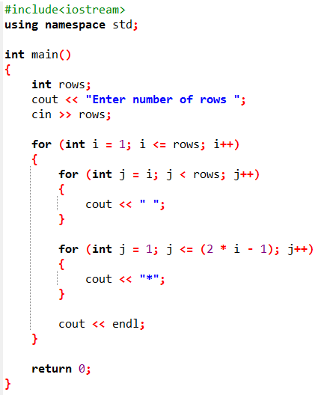
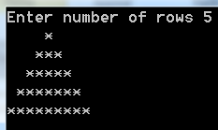
Output:

